Slide 1
NLP ASSIGNMENT
Sentimental Analysis of Movie Review
Submitted To-Mr.Rahul Sharma
Submitted by-Kritika Jain (DS6A-2019)

Slide 2







Introduction
Sentiment analysis is the process of using Natural Language Processing (NLP) to determine the emotional tone of textual data.
Objective: Analyze movie reviews to classify sentiments as either positive or negative

Slide 3
Dataset Overview
Source: IMDB Dataset.
Contents:
Two columns: review (textual review) and sentiment (positive/negative label).
Sentiments are converted into numeric format: 1 for positive, 0 for negative.

Slide 4
Data Preprocessing
Data Preprocessing
Import Libraries: Pandas, NumPy, sklearn, nltk, and re for processing.
Dataset Cleaning:
Handle missing data.
Map sentiments (Positive → 1, Negative → 0).

Slide 5
Text Preprocessing
Text Processing:
Removal of special characters using regular expressions.
Conversion of text to lowercase.
Tokenization and removal of stopwords (using NLTK's stopword list).

Slide 6
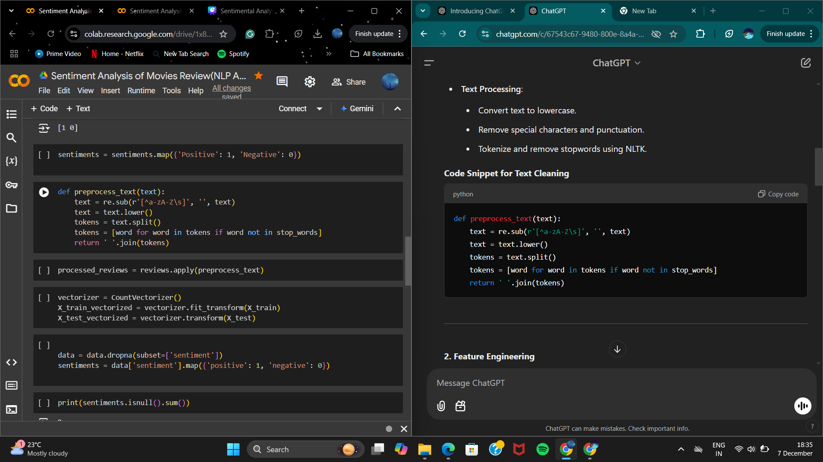
Data Processing

Slide 7
Feature Extraction
Method Used:
CountVectorizer for converting textual data into numerical format.
Vocabulary size is determined from the training data.

Slide 8
Model Selection
Algorithm Used: Multinomial Naive Bayes.
Reason for Selection: Effective for text classification tasks with categorical features.
Model Training and Testing
Data Split: 80% for training, 20% for testing using train_test_split.
Training: Model trained on vectorized reviews.
Evaluation Metrics:
Accuracy: Measures the percentage of correctly predicted sentiments.
Classification Report: Provides precision, recall, F1-score, and support.

Slide 9
Results
Accuracy Achieved: The model achieved notable performance on the test set.
Example Predictions:
Review: "The movie was bad! I hate it." → Negative Sentiment
Review: "The movie was fantastic! I love it." → Positive Sentiment

Slide 10
Conclusion
Key Insights:
Sentiment analysis can automate review classification.
Useful for businesses to analyze customer feedback.
Future Improvements:
Experimenting with advanced models like deep learning.
Enhancing preprocessing with techniques like lemmatization.

Slide 11

Thank You
FINISH

